Slide 1



HEART DISEASE
PREDICTION
NUR SHAHEERA BINTI KAMIS (2214040)
AMIRAH HUDA BINTI JAMALULAIL ASRI (2210776)
NUR FATIHAH HANNANI BINTI HASMAYADI (2227062)

Slide 2



WHAT IS HEART DISEASE?
The term “heart disease” is often used similarly with the term “cardiovascular disease”. Cardiovascular diseases involve the heart or blocked blood vessels that can lead to a heart attack,
chest pain or stroke. Conditions like heart failure occur when the heart cannot pump effectively. Predicting the risk of heart problems can be crucial for early intervention and preventive measures.

Slide 3
HOW TO PREDICT?
Neural networks have the potential to identify complex patterns and offer predictions that could be valuable for medical professionals and individuals. By reviewing historical heart rate data, along with related medical indicators, this research aims to measure the ability of neural networks to provide accurate predictions of heart rate fluctuations. The use of neural networks in heart rate prediction shows potential for improving healthcare monitoring, allowing prompt interventions, and enhancing overall well-being.

Slide 4
WHY WE CHOOSE NEURAL NETWORK?
Neural networks are great at handling large amounts of data. This makes them ideal for heart rate prediction, where vast amounts of medical information are involved.
Neural networks excel at spotting complex connections in data, which is critical for predicting heart risk accurately. It uncover hidden connections between factors like blood pressure, cholesterol, family history, and heart rate.

Slide 5
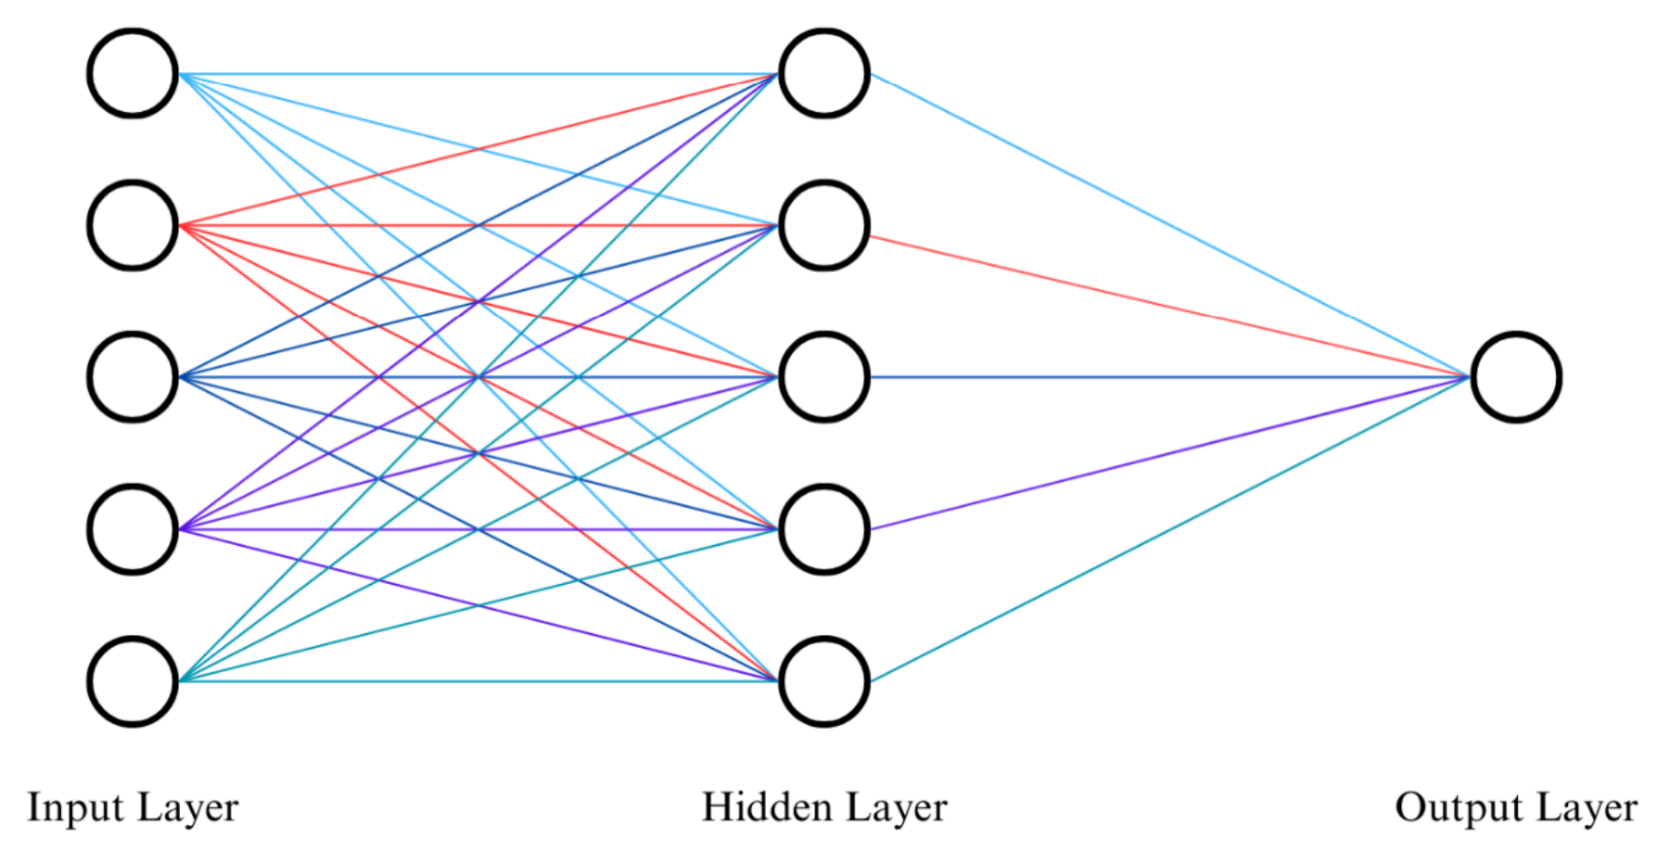

Slide 6

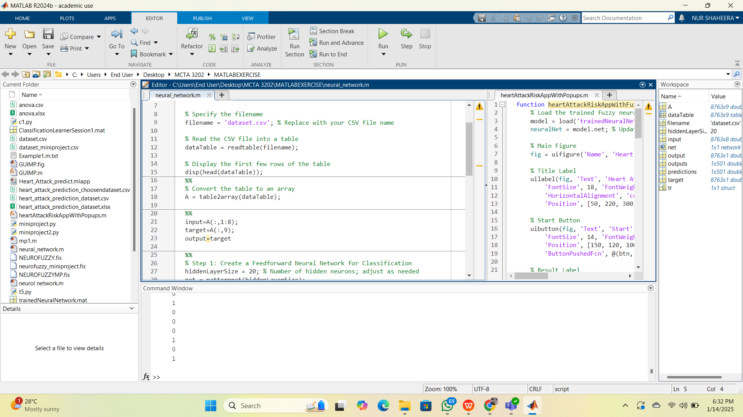
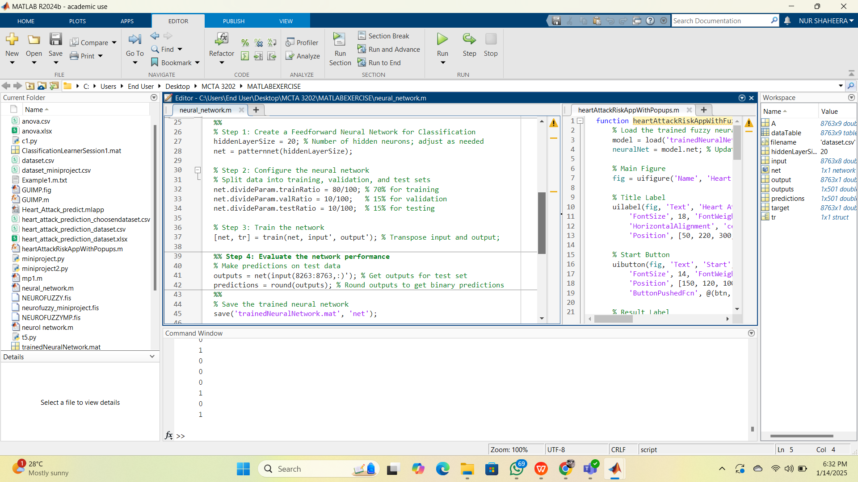
NEURAL NETWORK CODE

Slide 7
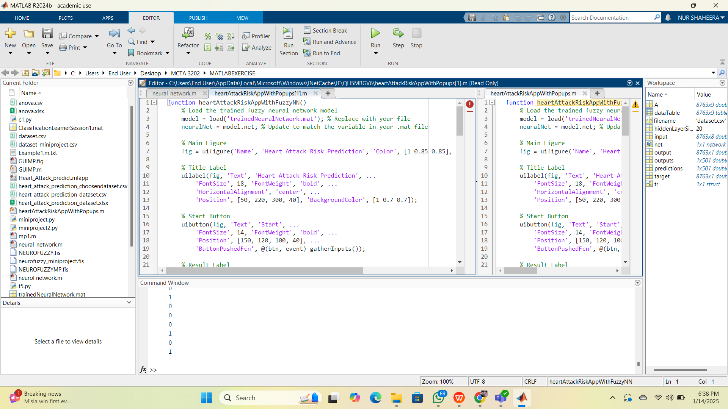
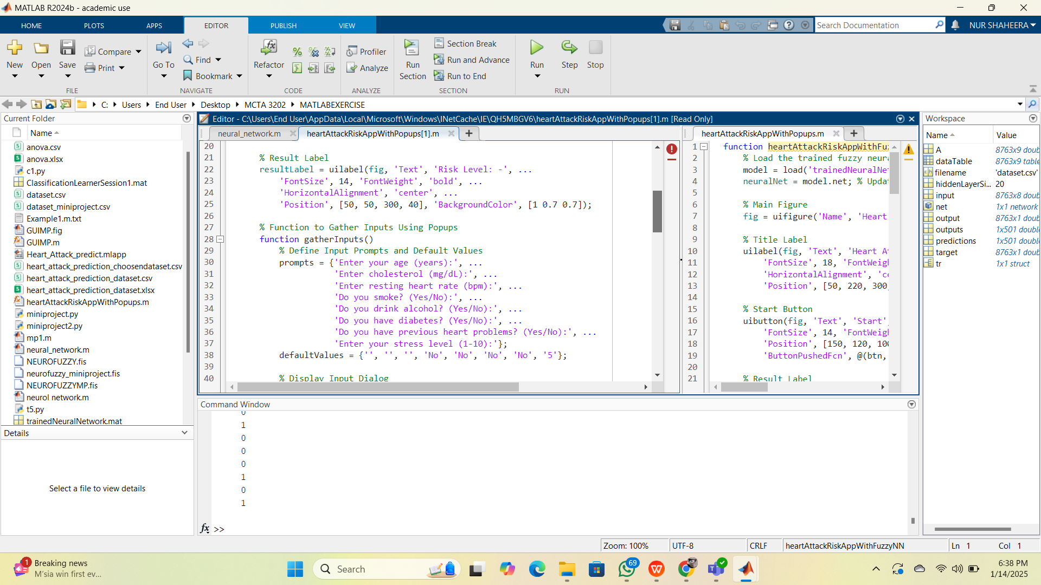
GUI CODE

Slide 8
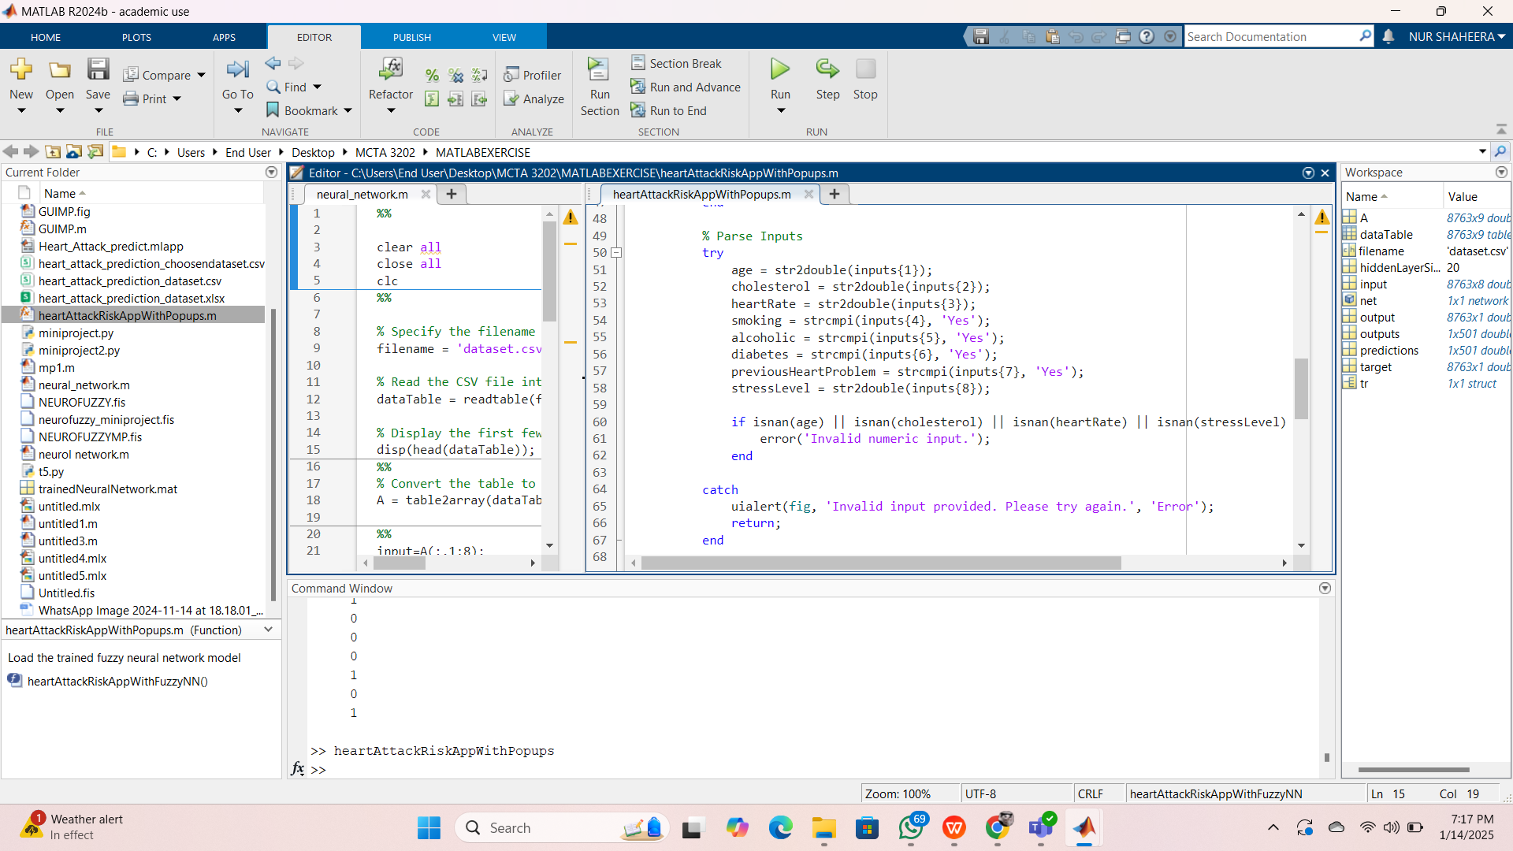

GUI CODE

Slide 9
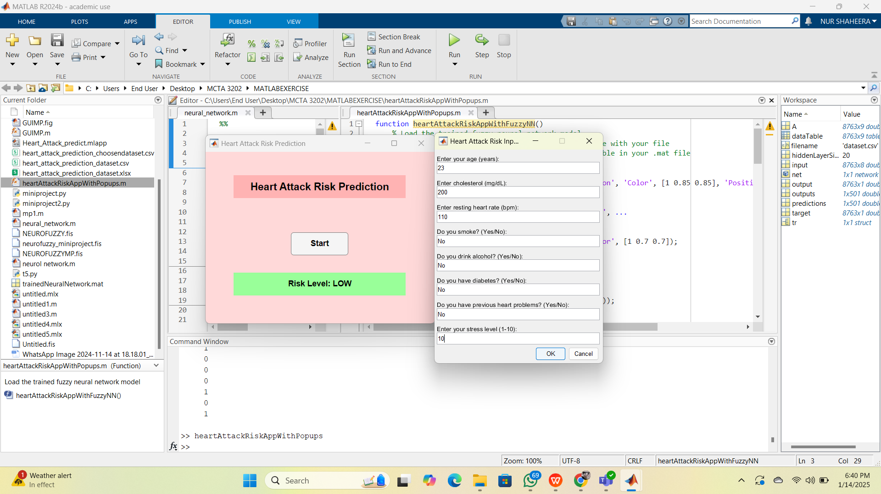
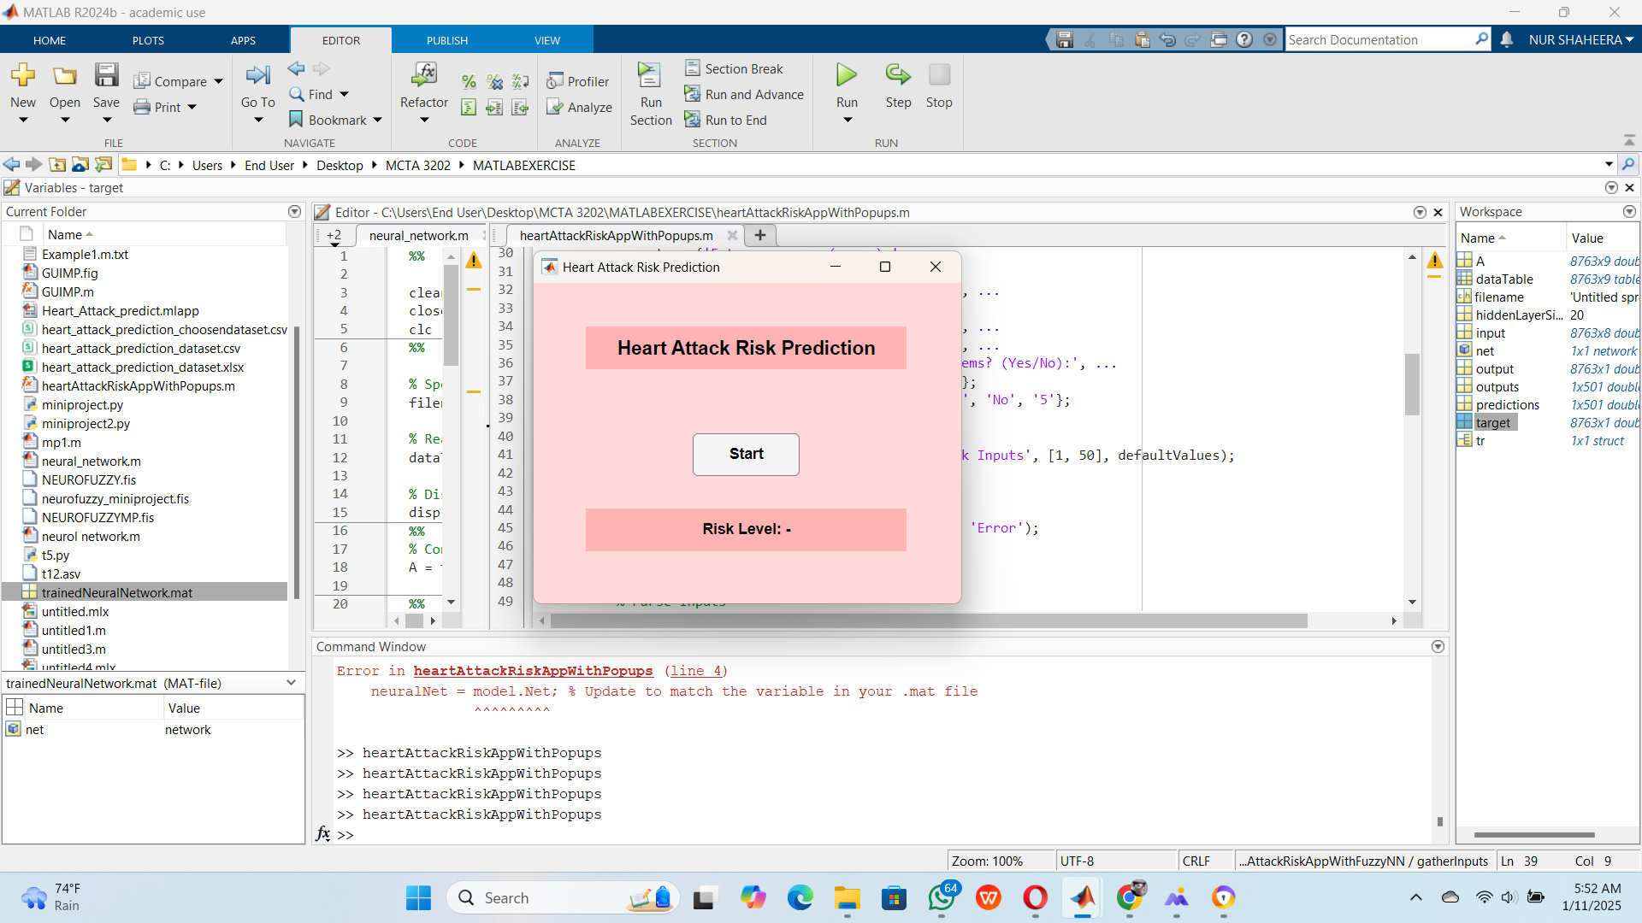
GRAPHICAL USER INTERFACE

Slide 10

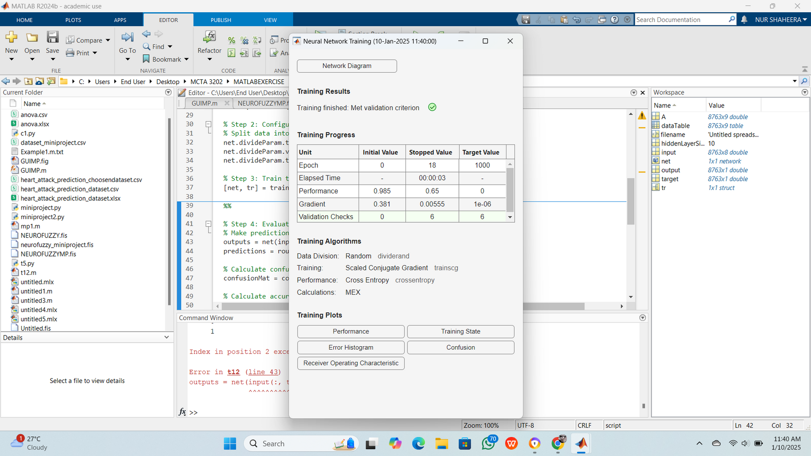

EVALUATION
The progress of the neural network training shows effective convergence within a short period. The training process stopped at epoch 18, well before the maximum target of 1000 epochs, indicating that the network successfully met the validation criterion early on.

Slide 11

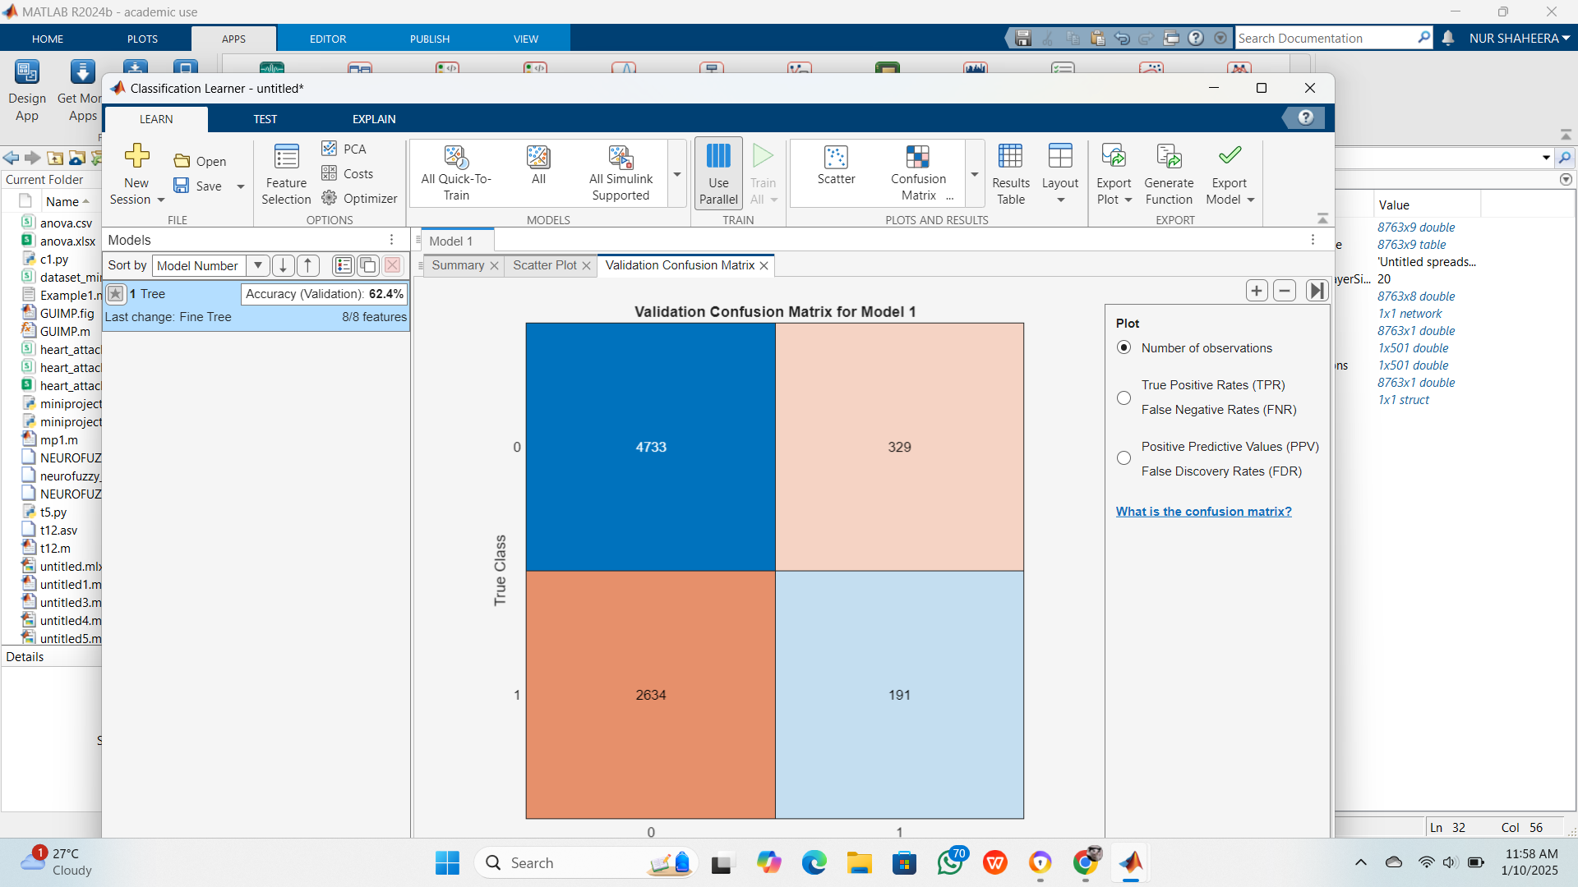
VALIDATION
For this project, the test accuracy reached 62.40%.This means that the test prediction is substantial. A few variables that have a big .impact on the data, may not be included. The accuracy of the heart attack risk increases with training data volume.

Slide 12

CONCLUSION
In conclusion, this study examined the use of neural network models for heart attack riskprediction analysis. We were able to use a neural network to successfully achieve the results.

Slide 13


THANK
YOU

